Slide 1

Advanced Attendance Management System Integrating Face Recognition and GPS-Based Tracking
Presented by
K.N.S.Sesha Kumar – 211FA18112
Sk.Siraj – 211FA18101
Department of ACSE
VFSTR Deemed To Be University
Under Guidance of
Mr. Amar Jukuntla
Assistant Professor,
Department of ACSE,
VFSTR Deemed To Be University

Slide 2
INDEX
Problem Statement
Motivation
Literature Survey
Tools Used
Conclusion
Methodology
References

Slide 3
Problem Statement
Conventional attendance systems like registers, RFID, and biometrics are vulnerable to proxy entries, hardware issues, and lack scalability. They often fail to ensure real-time identity and location verification, compromising accuracy and security. A smarter, mobile-based solution is needed to enable secure, location-aware, and tamper-proof attendance.

Slide 4
Motivation
The motivation behind this project stems from the need for modernizing and enhancing traditional attendance tracking methods within educational institutions.
By combining location-based services, facial recognition, and deep learning techniques, this project seeks to revolutionize attendance management.
This project aspires to alleviate the administrative burden of attendance monitoring and promote a technologically advanced learning environment through innovative solutions that simplify routine tasks.

Slide 5
Literature Review – Existing Approaches
Face Recognition Techniques:
Haar Cascade & LBPH
→ Lightweight but less accurate in real-world settings.
PCA/LDA + k-NN
→ Fast with ~85–88% accuracy. Good for embedded systems.
MobileFaceNet (used in our system)
→ Lightweight, TFLite-ready, ~96% accuracy, optimized for mobile.
Geolocation & Geofencing:
Traditional circular zones: poor corner detection.
Murali (2024): GPS radius approach → suffers GPS drift (±93m).
Shahab (2020): ReactJS + geofence → 90–98% accurate but slow (1.8–4s).
Our system: Polygon-based geofencing + raycasting → precise boundary detection even in irregular zones.

Slide 6
Hybrid Systems – Key Insights
Study | Tech Stack | Strengths | Limitations
Ray (2025) | Face + IP geolocation | Real-time logging | Needs internet, less accurate
Murali (2024) | Multi-CNN + GPS | Alerts + Cloud Storage | High latency + privacy risks
Sunaryono (2021) | QR + LDA/k-NN + RaspberryPi | Fast & accurate (97%) | Hardware dependency
Our System | TFLite + Polygon Geofence | Offline, secure, precise GPS + face auth | None reported in current deployment
Privacy Note:
Most existing systems send biometric data to the cloud.
Our Approach: Fully on-device face recognition, AES-256 encryption, and no external face data transmission.

Slide 7

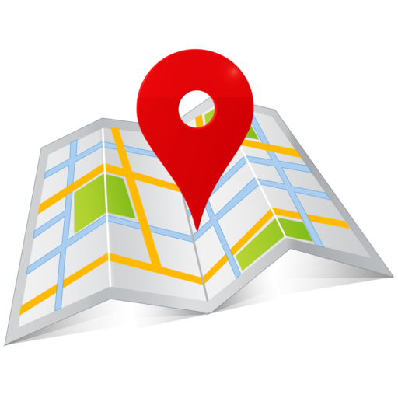


Technologies Used
MobileFaceNet (TFLite):
Efficient CNN architecture tailored for face recognition on mobile devices – enables secure, fast user verification.
TFLite (TensorFlow Lite):
Lightweight deep learning model runtime for on-device facial embedding extraction using MobileFaceNet.
GPS & Geolocation APIs:
Real-time location capture to validate user presence via ray casting-based geofence detection.
Firebase:
Serverless backend for storing user data, attendance logs, and syncing with the dashboard and mobile app.
OAuth-based secure sign-in for faculty users using their institutional Gmail.
Google MyMaps:
Used to define and export geofence boundaries (polygon coordinates) for GPS validation.
Firebase ML Kit:
Built-in API for on-device face detection before passing data to MobileFaceNet.
Flask (Python):
Used to build the Admin Dashboard backend – handles user management, attendance logs, and
real-time data rendering.
GPS

Slide 8
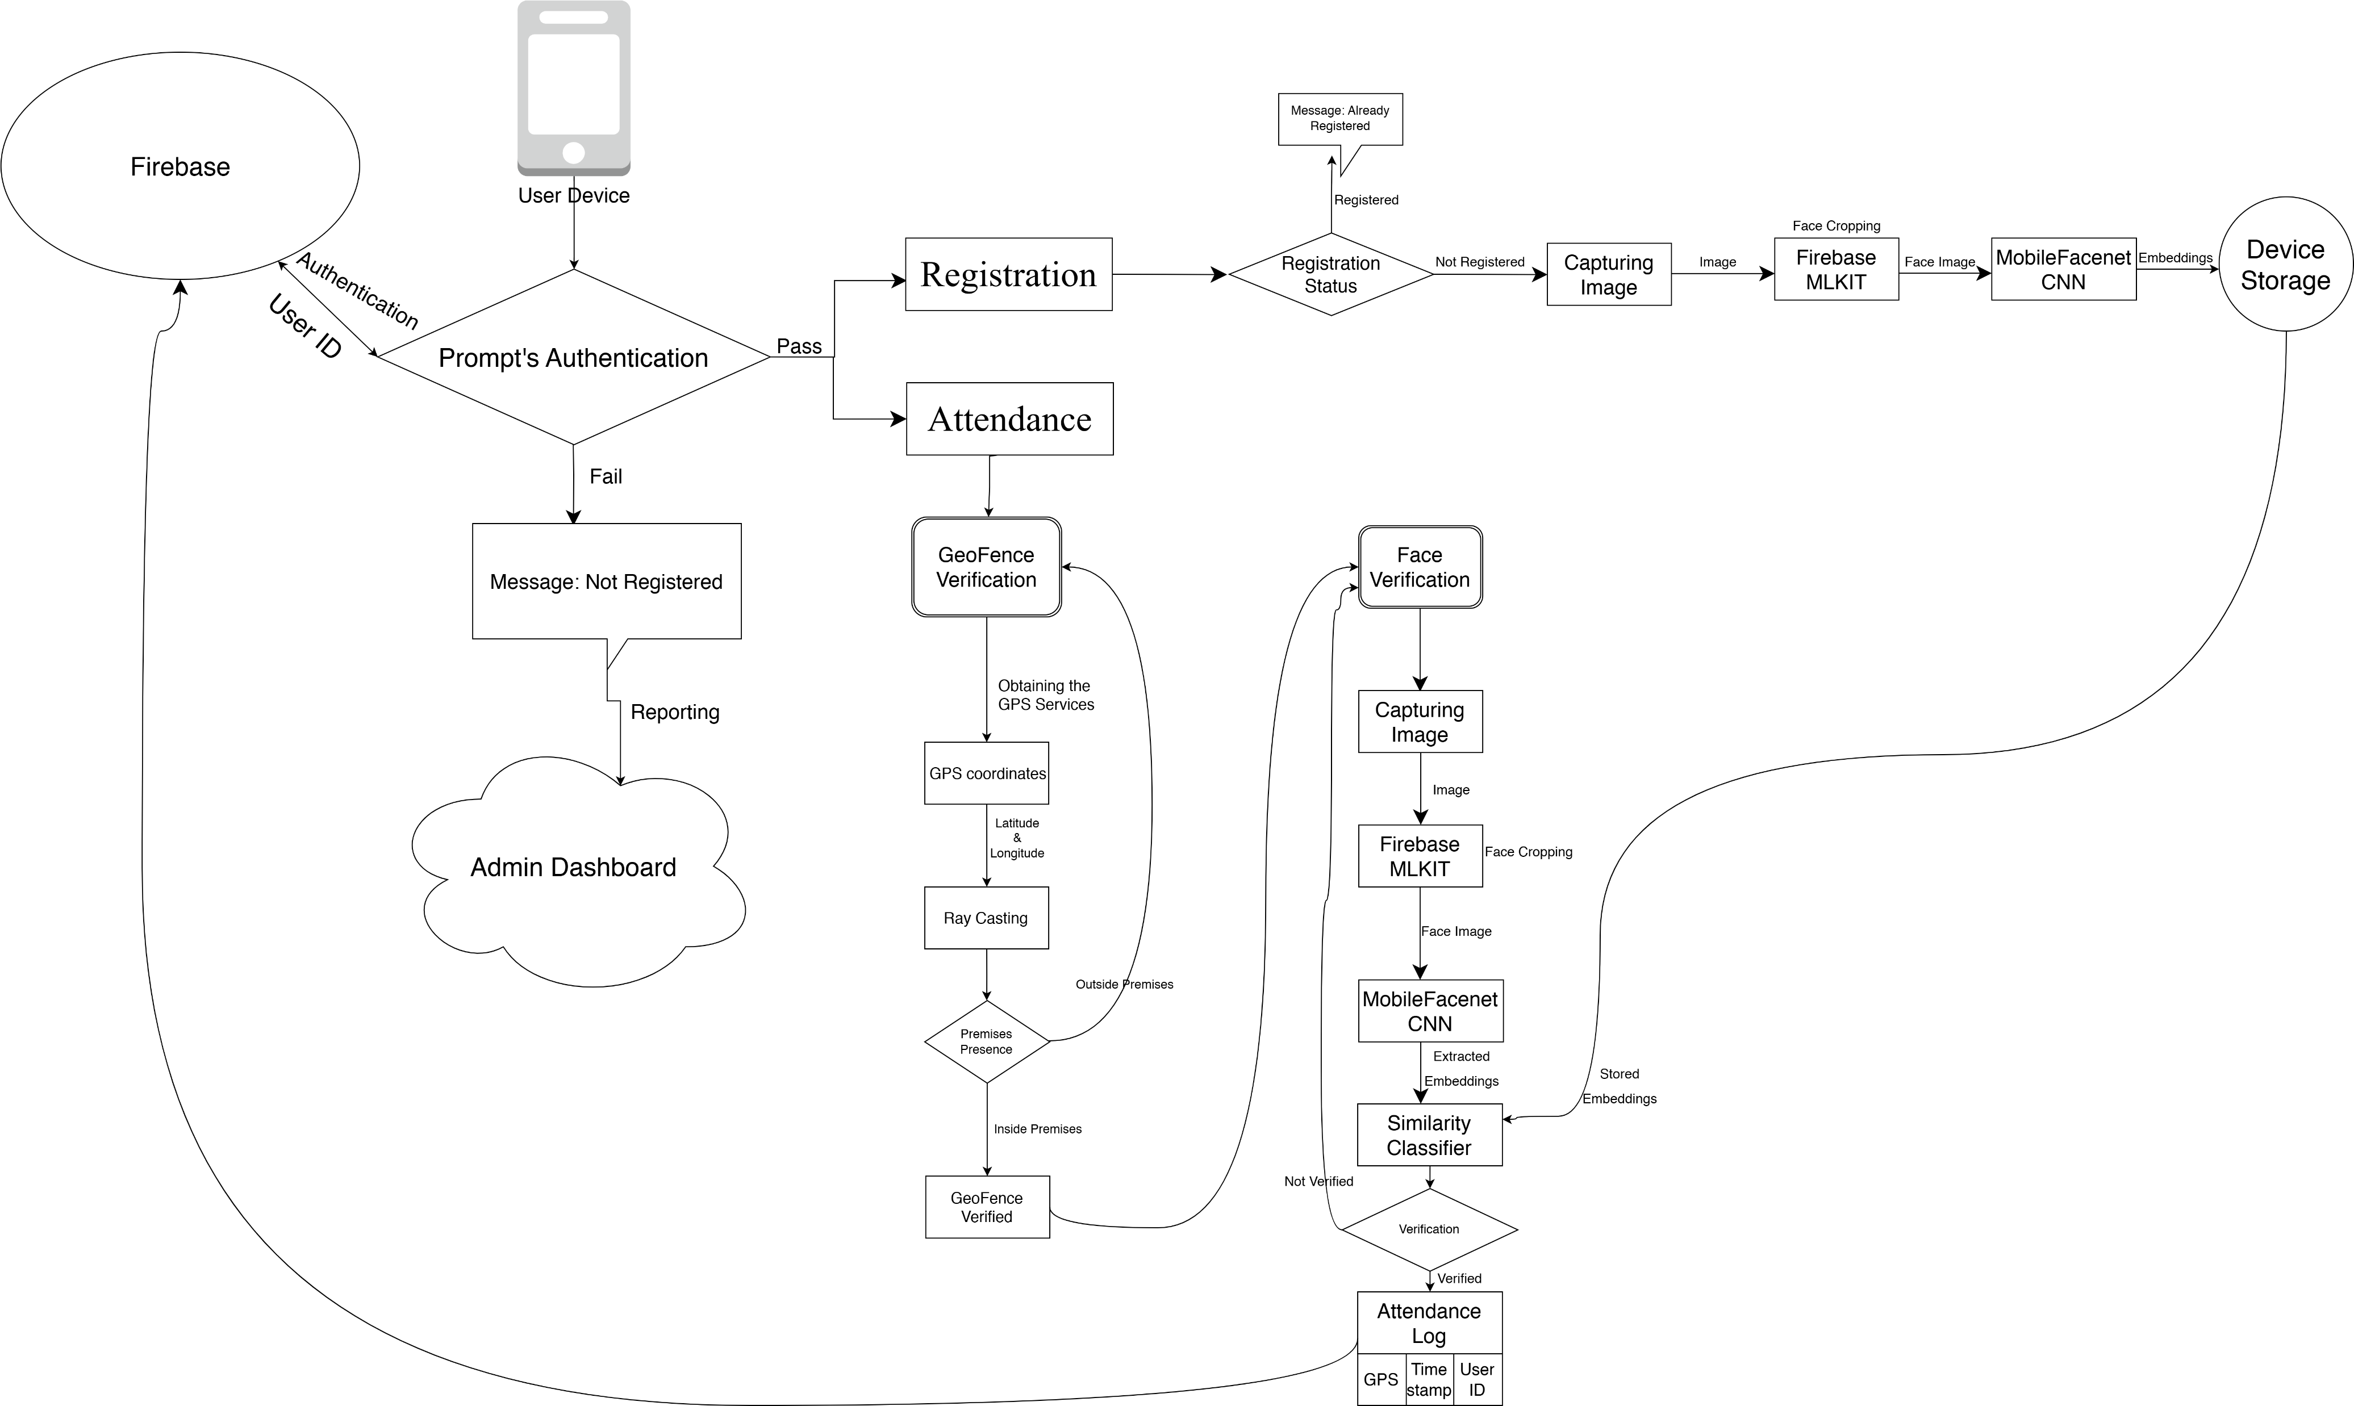
Methodology

Slide 9
Admin Phase
User credentials
1.Login password
2.Face Data Collection
Define GeoFencing
Application Testing
Model Creation
UI Design

Slide 10
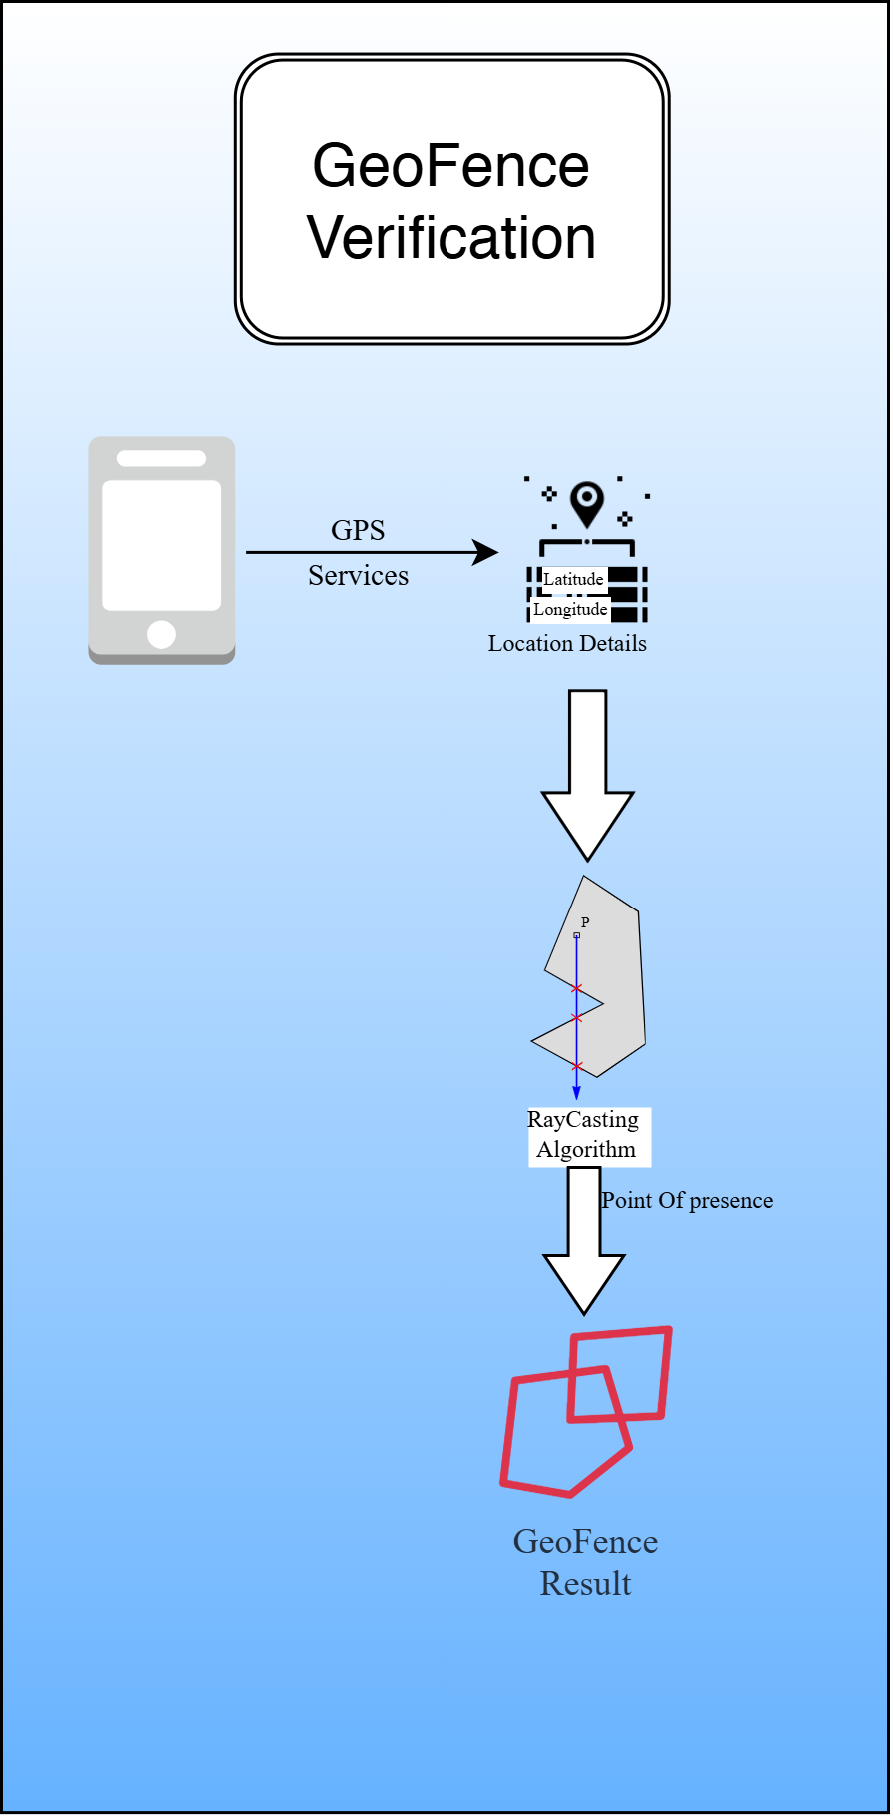
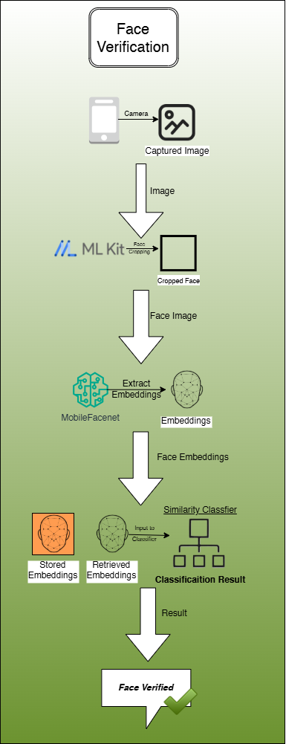
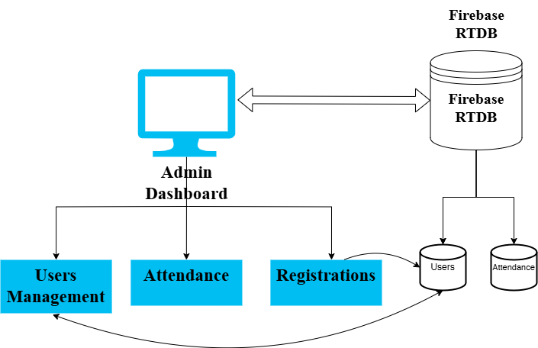
User Verification Steps

Slide 11
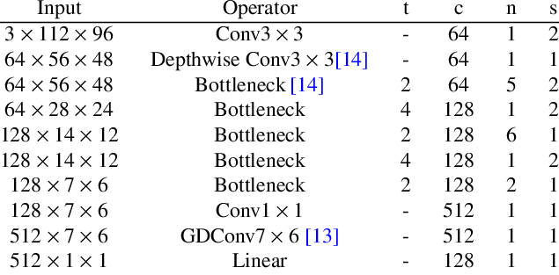
Mobile Facenet - Architecture

Slide 12
Why MobileFaceNet?
Lightweight & Efficient: Designed specifically for mobile devices using depthwise separable convolutions, enabling real-time face recognition with low resource usage.
High Accuracy: Achieves ~96–98% verification accuracy on LFW benchmark while being 4–5× smaller than FaceNet and other deep models.
Fast InferenceEmbedding: generation takes <100 ms on mid-range Android devices, suitable for real-time attendance applications.
Optimized for TFLite: Easily integrates into Android apps via TensorFlow Lite, enabling on-device inference without cloud dependence.
Privacy-Friendly: Embeddings stay on the device, ensuring user biometric data is never transmitted or stored externally.

Slide 13
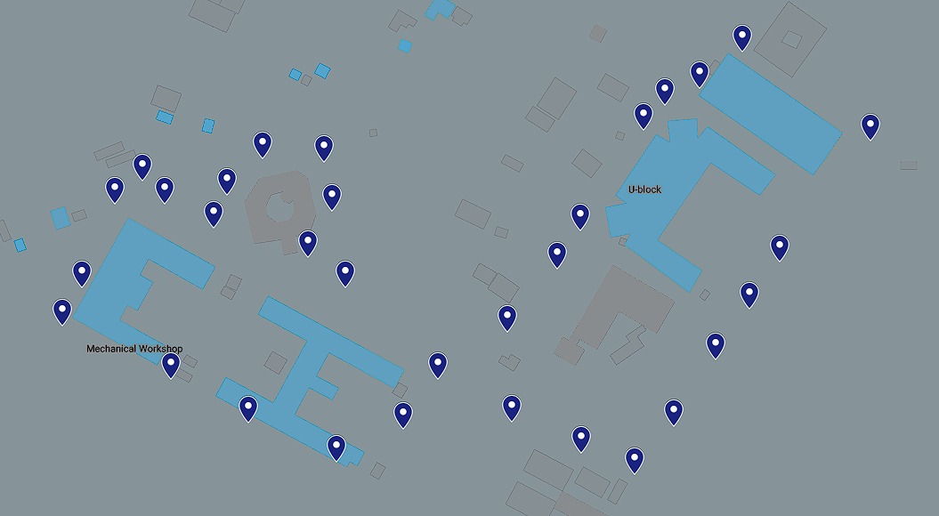
Geofencing
VFSTR , GUNTUR

Slide 14
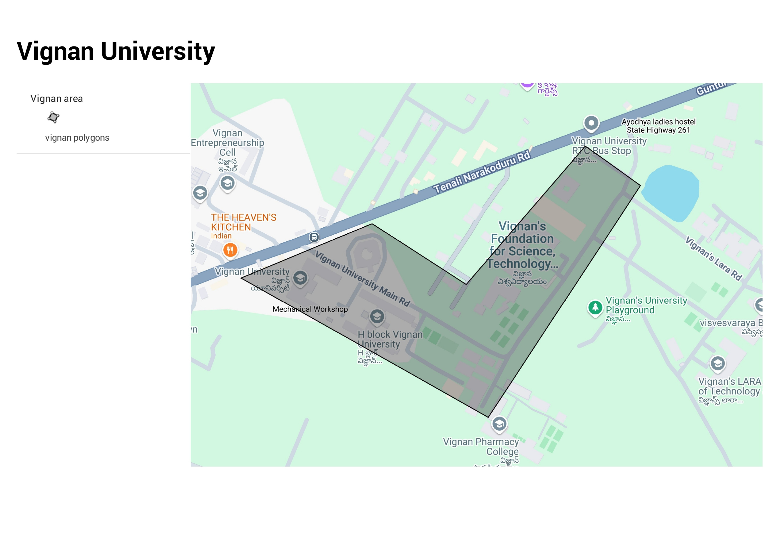
GeoFence

Slide 15
Results
Face Recognition Accuracy
Achieved ~98.1% true positive rate under well-lit conditions.
Maintained >94% accuracy in varied lighting and device angles.
Average recognition time: ~1.1 seconds on mid-range devices.
Geofencing Validation
Polygon-based raycasting approach ensured ~97.5% overall accuracy.
Precise boundary detection even with 6, 8, and 12-sided geofences.
False positives reduced near edges compared to circular models.

Slide 16

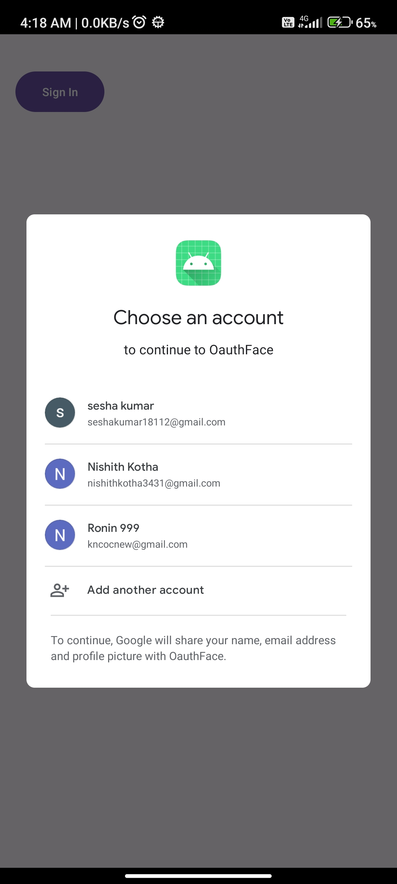
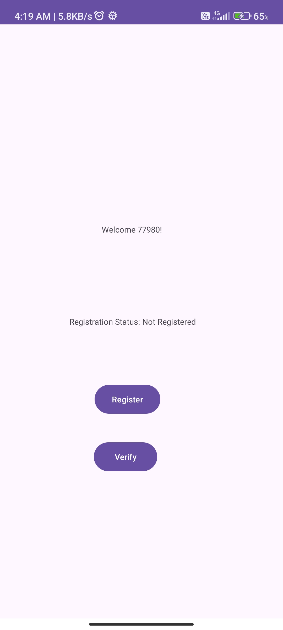
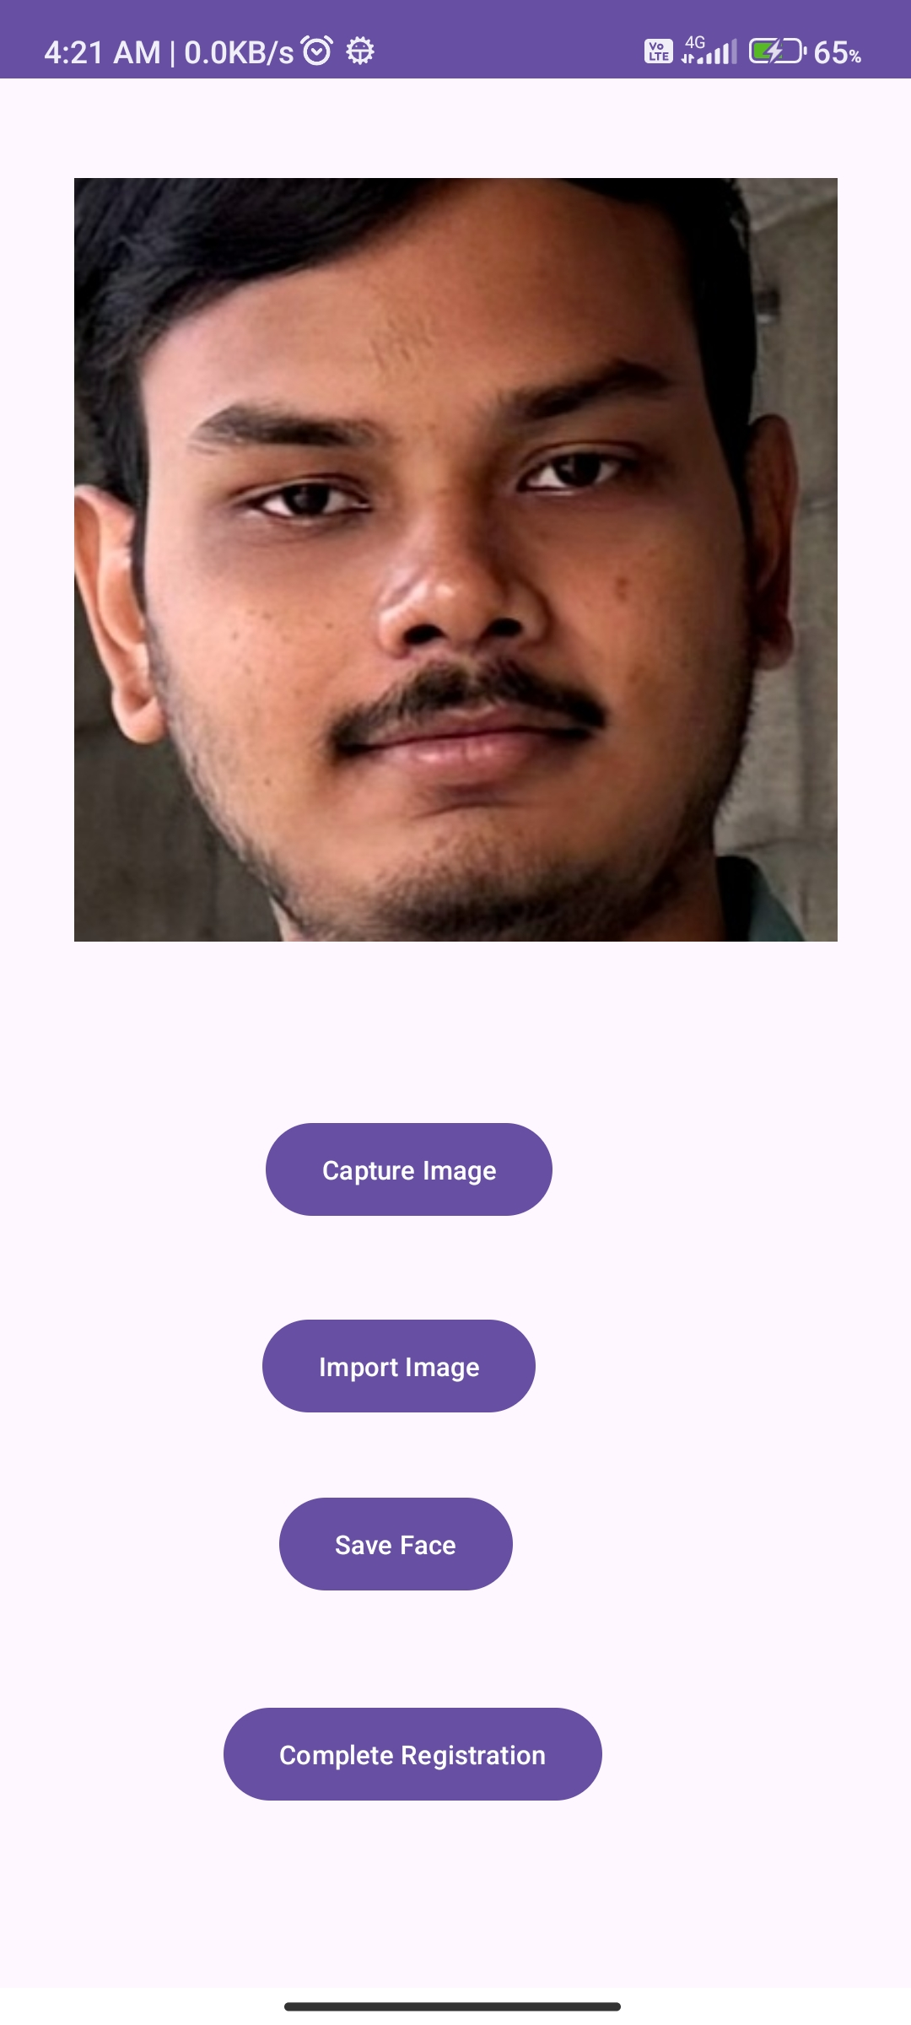
App Interface

Slide 17
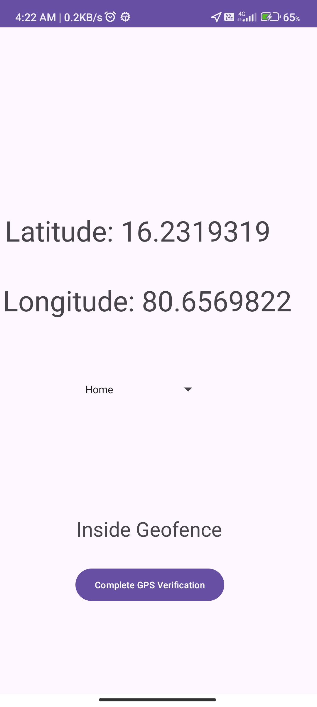
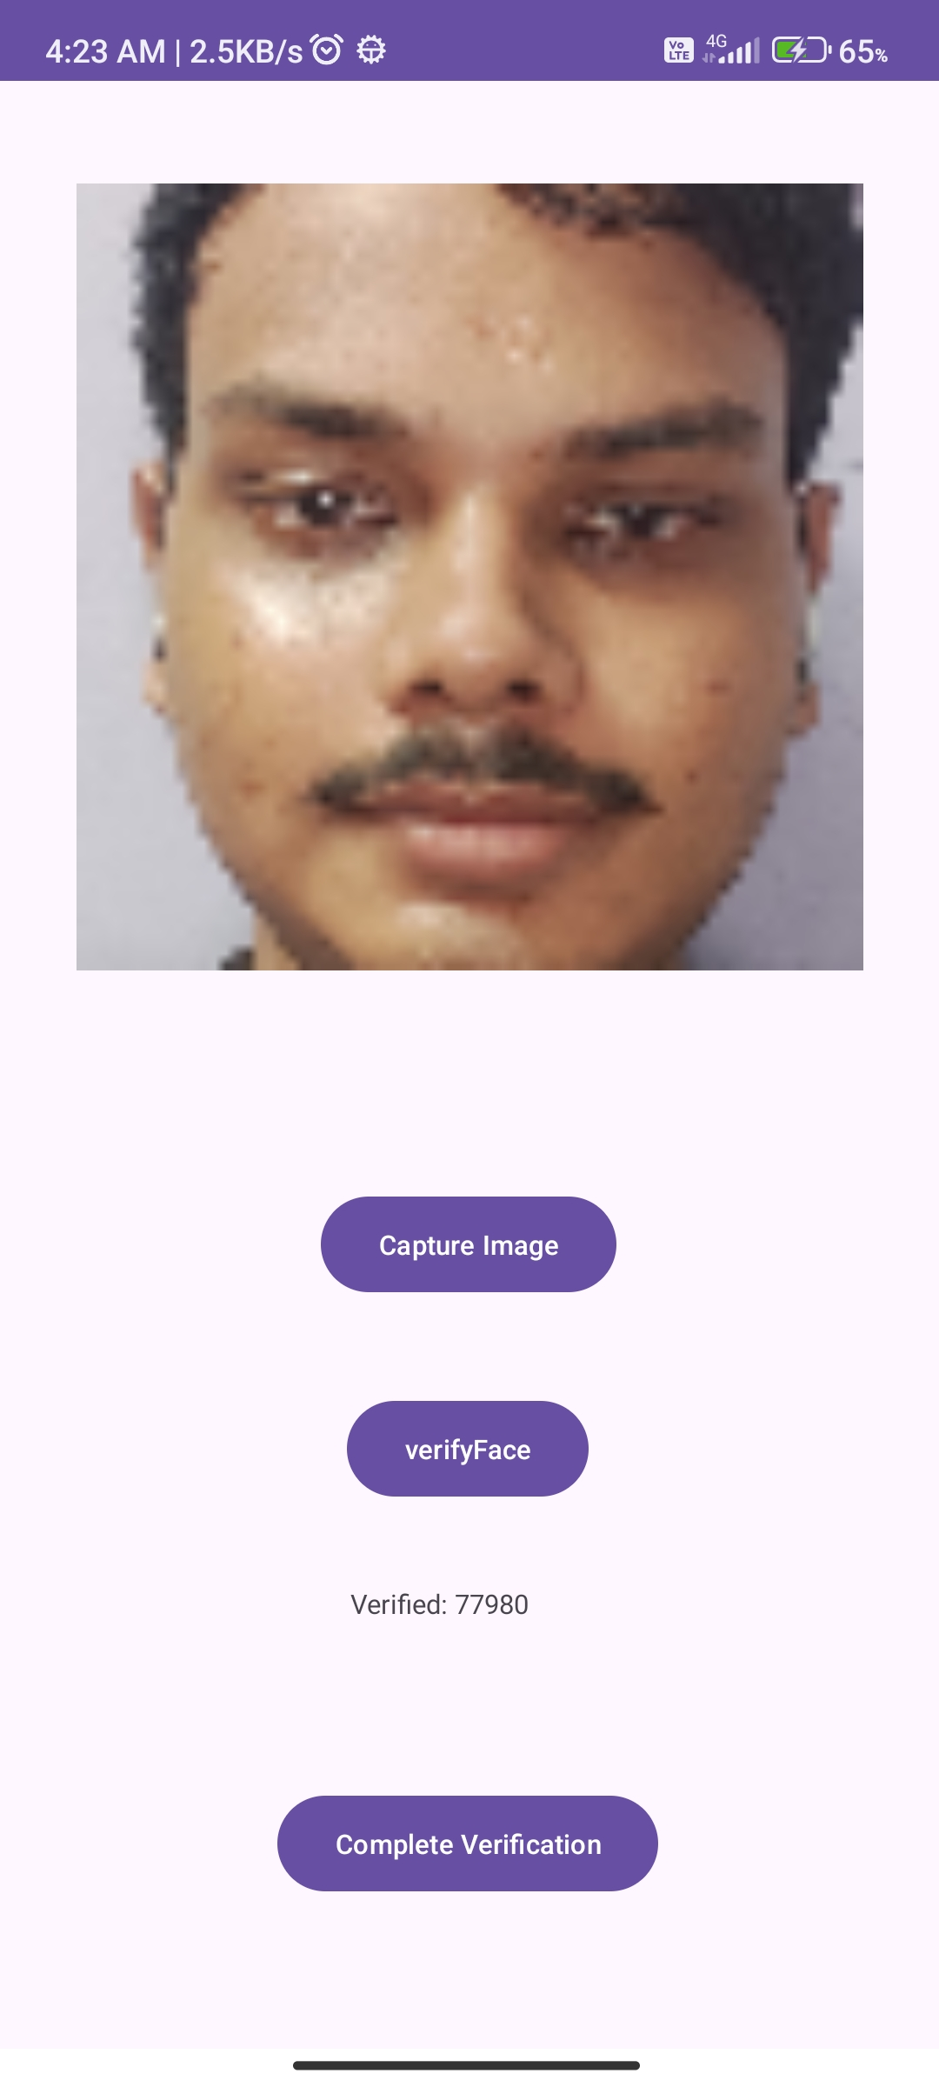
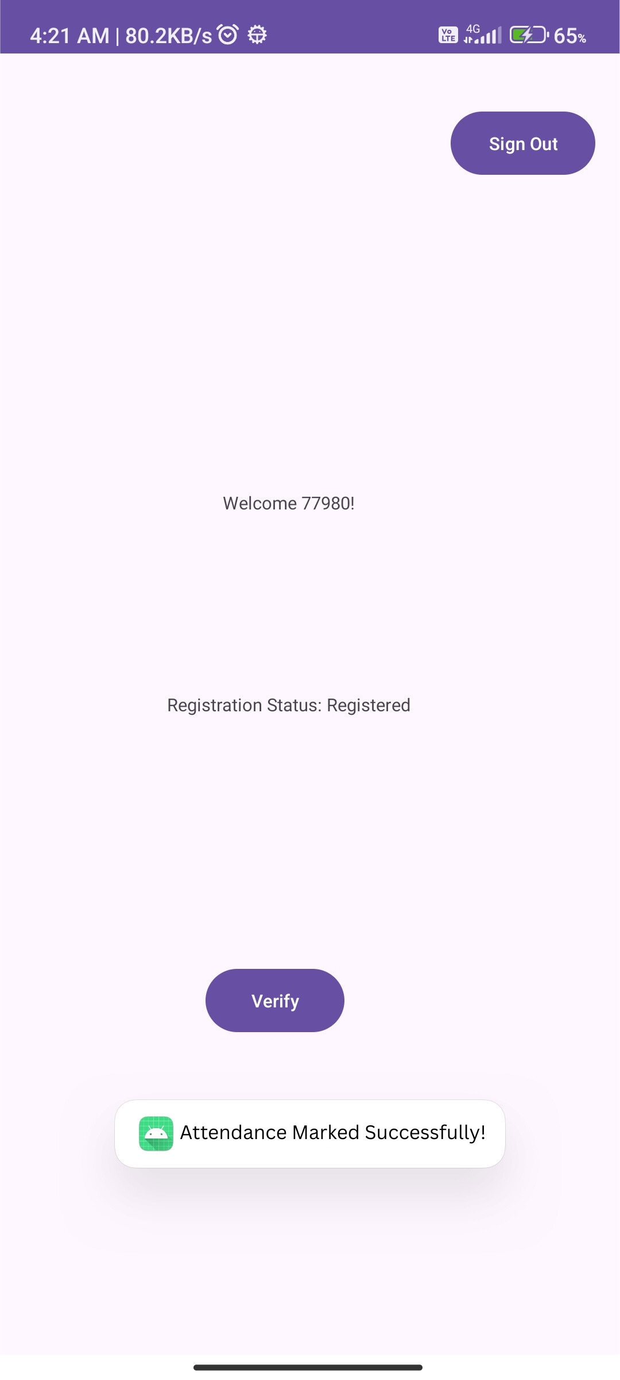
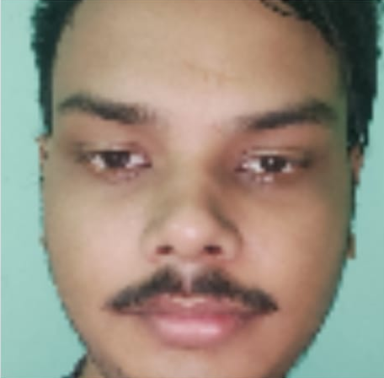
Continues…

Slide 18
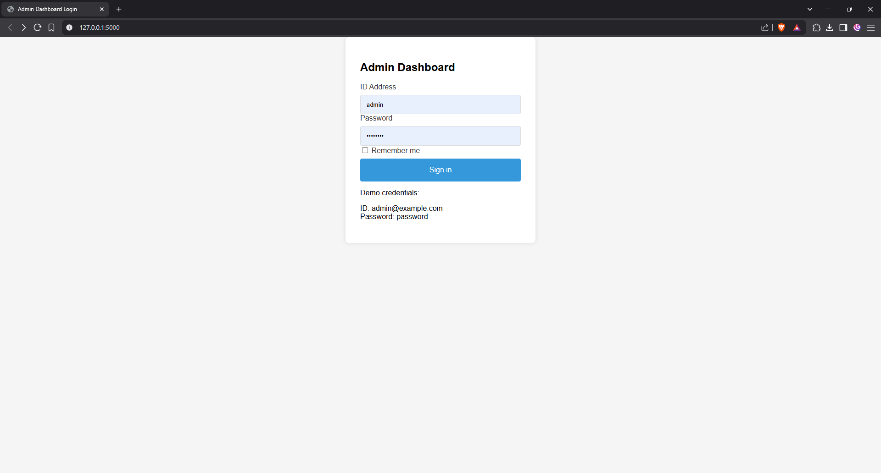
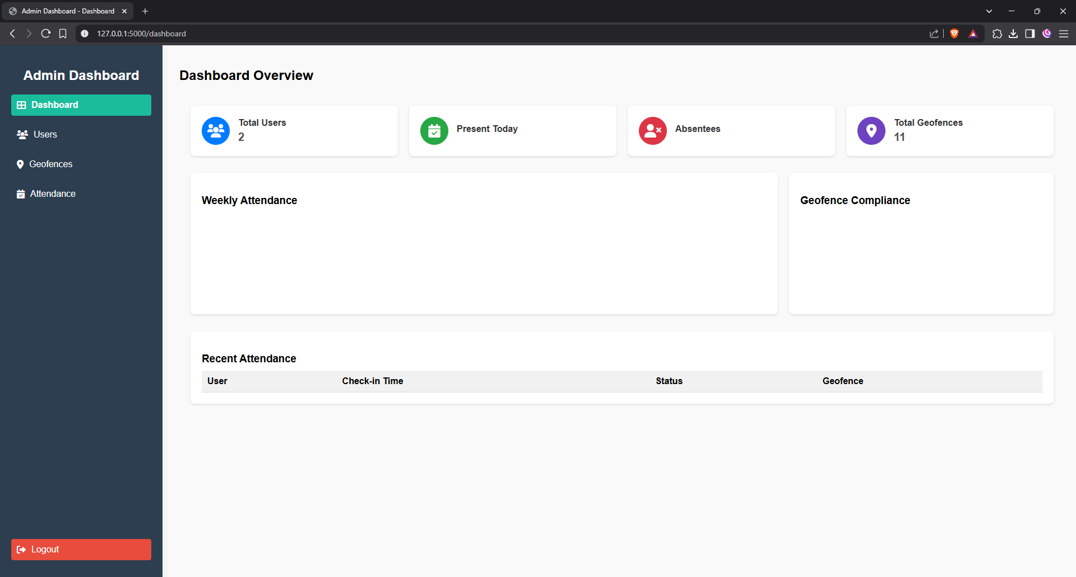
Admin Dashboard

Slide 19
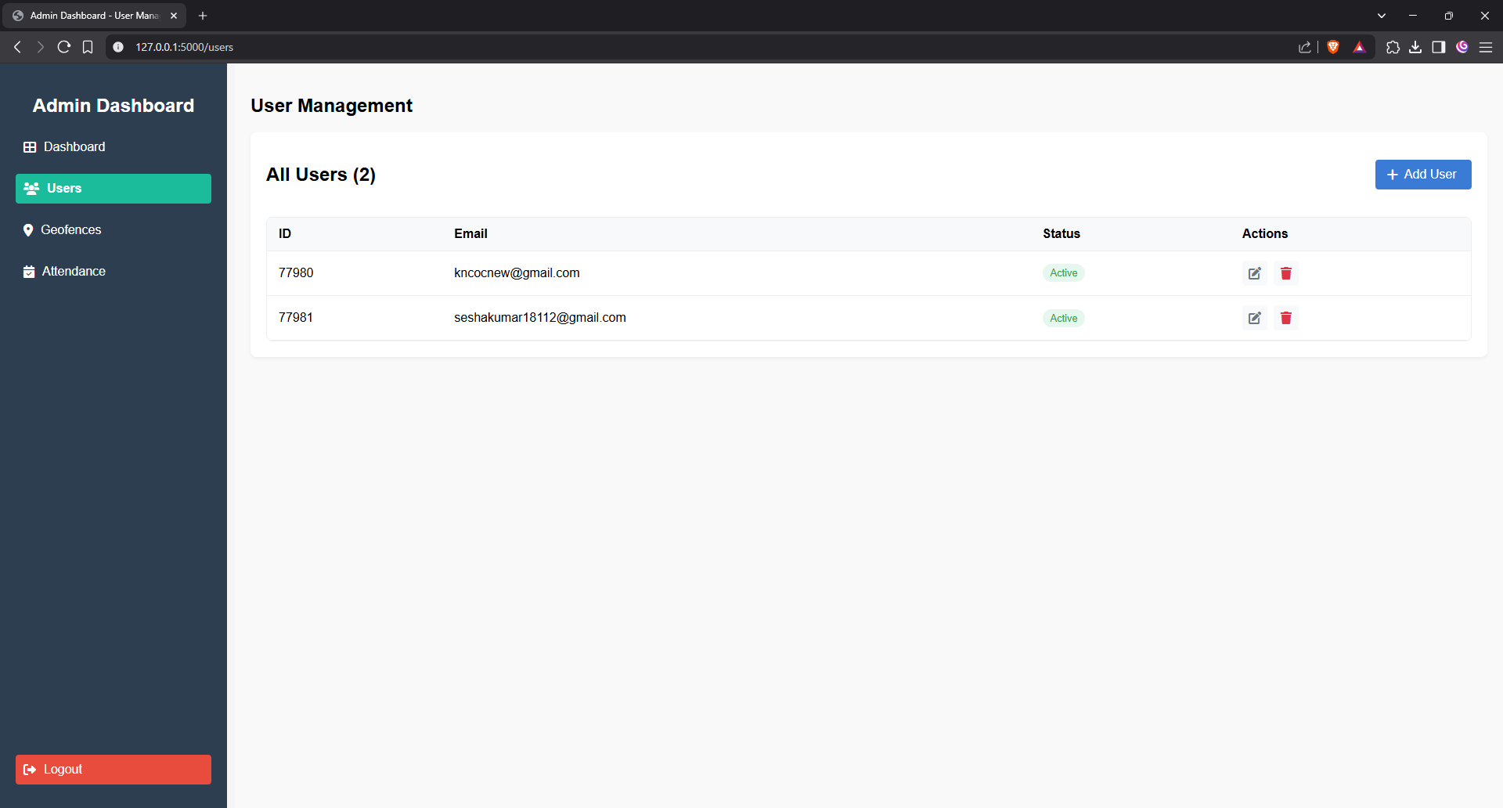
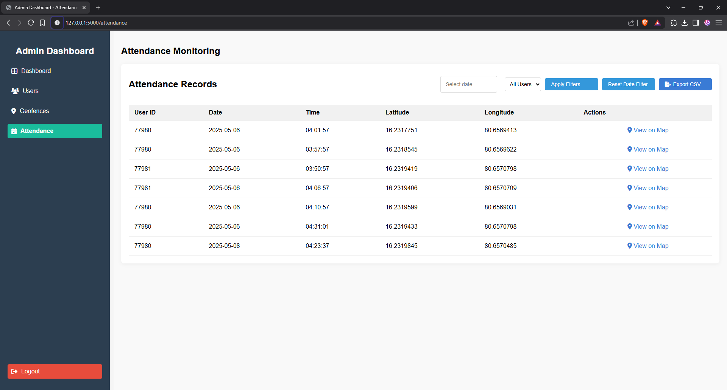
Continue..

Slide 20
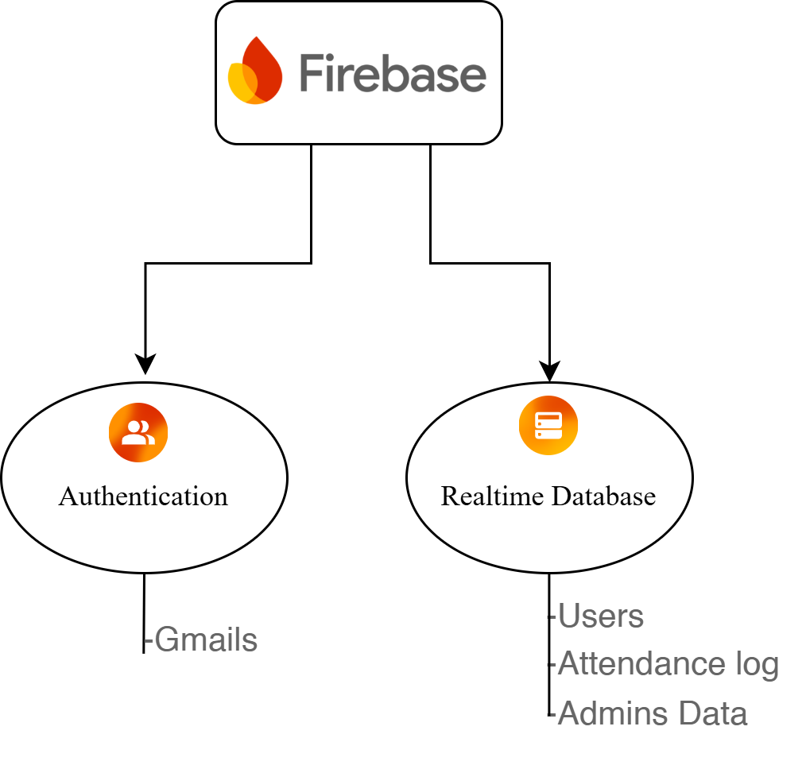
Backend - Firebase Services

Slide 21
Conclusion
The proposed system successfully integrates face recognition (using MobileFaceNet) and geolocation-based geofencing to enable secure, real-time, and tamper-proof attendance marking.
Designed as a mobile-first solution, it performs on-device face verification, ensuring both privacy and offline capability, unlike traditional cloud-dependent systems.
Polygon-based geofencing using the raycasting algorithm enhances spatial precision, even in complex or irregularly shaped areas like campuses or multi-building institutions.
Firebase Authentication and Realtime Database offer a scalable, secure, and synchronized backend for both user-side and admin-side operations.
The integrated Admin Dashboard enables real-time monitoring, user management, and attendance analytics, improving administrative efficiency.
Overall, the system addresses critical shortcomings of traditional attendance systems and paves the way for scalable deployment in both educational and enterprise environments.

Slide 22
References
[1] V. Chauhan and I. Kumar, "Efficient employee tracking with smart attendance system using advanced face recognition and geofencing," in Proc. IEEE Conf. Recent Adv. Comput. Sci. Eng. (RACSE), Dehradun, India: Hill University, 2024. https://ieeexplore.ieee.org/document/10625038
[2] D. Ray, "A face recognition based attendance system with geolocation and real-time action logging," Research Square, 2025. https://doi.org/10.21203/rs.3.rs-5931462/v1
[3] K. Bhambure, B. Deore, A. Kadam, K. Dabhade, and P. Gaikwad, "An integrated face recognition based attendance monitoring system," JOIV: Int. J. Informatics Vis., vol. 7, no. 2, p. 2464, 2023 https://joiv.org/index.php/joiv/article/view/2464
[4] D. Sunaryono, J. Siswantoro, and R. Anggoro, "An android based course attendance system using face recognition," J. King Saud Univ. - Comput. Inf. Sci., vol. 33, no. 3, pp. 304–312, 2021.
https://doi.org/10.1016/j.jksuci.2019.01.006
[5] A. S. Shahab and R. Sarno, "Android application for presence recognition based on face and geofencing," in Proc. 2020 Int. Seminar Appl. Technol. Inf. Commun. (iSemantic), 2020, pp. 208–213. [Online]. Available: https://ieeexplore.ieee.org/document/9234236
[6] N. Murali, R. Rajesh, S. Sridharan, A. E. P. Mariadas, S. P. Murugan, and S. Manikandan, "A GPS-based face attendance register system using Android applications stored in the cloud," in Proc. 2024 11th Int. Conf. Comput. Sustainable Global Dev. (INDIACom), New Delhi, India, 2024, pp. 17–22. doi: 10.23919/INDIACom61295.2024.10498447
[7] Zaferani, H., Kiani, K. & Rastgoo, R. Real-time face verification on mobile devices using margin distillation. Multimed Tools Appl 82, 44155–44173 (2023). https://doi.org/10.1007/s11042-023-15510-x.

Slide 23
More References
[8] A. Jadhav, A. Jadhav, T. Ladhe, and K. Yeolekar, "Automated attendance system using face recognition," Int. Res. J. Eng. Technol. (IRJET), vol. 4, no. 1, pp. 1467–1471, Jan. 2017. [Online]. Available: https://www.irjet.net/archives/V4/i1/IRJET-V4I1285.pdf
[9] A. Krishna, N. Manoj, and T. Subbulakshmi, "Design and development of attendance system using face recognition," in Proc. 2024 4th Int. Conf. Soft Comput. Secur. Appl. (ICSCSA), 2024, pp. 695–701. IEEE. doi: 10.1109/ICSCSA59046.2024.10473892
[10] N. Murali, R. Rajesh, S. Sridharan, A. E. P. Mariadas, S. P. Murugan, and S. Manikandan, "A GPS-based face attendance register system using Android applications stored in the cloud," in Proc. 2024 11th Int. Conf. Comput. Sustainable Global Dev. (INDIACom), New Delhi, India, 2024, pp. 17–21. doi: 10.23919/INDIACom61295.2024.10498447
[11] D. Ray, "A face recognition based attendance system with geolocation and real-time action logging," Research Square, 2025. https://doi.org/10.21203/rs.3.rs-5931462/v1
[12] A. S. Shahab and R. Sarno, "Android application for presence recognition based on face and geofencing," in Proc. 2020 Int. Seminar Appl. Technol. Inf. Commun. (iSemantic), 2020, pp. 208–213. [Online]. Available: https://ieeexplore.ieee.org/document/9234236
[13] D. Sunaryono, J. Siswantoro, and R. Anggoro, "An android based course attendance system using face recognition," J. King Saud Univ. - Comput. Inf. Sci., vol. 33, no. 3, pp. 304–312, 2021. https://doi.org/10.1016/j.jksuci.2019.01.006
[14] A. Trivedi, C. M. Tripathi, Y. Perwej, A. K. Srivastava, and N. Kulshrestha, "Face recognition based automated attendance management system," Int. J. Sci. Res. Sci. Technol., vol. 9, no. 1, pp. 261–268, Jan.–Feb. 2022. [Online]. Available: https://ijsrst.com/IJSRST229133
[15] H. Zaferani, K. Kiani, and R. Rastgoo, "Real-time face verification on mobile devices using margin distillation," Multimed. Tools Appl., vol. 82, pp. 44155–44173, 2023. https://doi.org/10.1007/s11042-023-15510-x
[16] C. Zhao and X. Huang, "Attendance system based on face recognition and GPS tracking and positioning," in Proc. 2020 2nd Int. Conf. Appl. Mach. Learn. (ICAML), 2020, pp. 78–83. IEEE. doi: 10.1109/ICAML50735.2020.9233883

Slide 24

.

